Slide 1
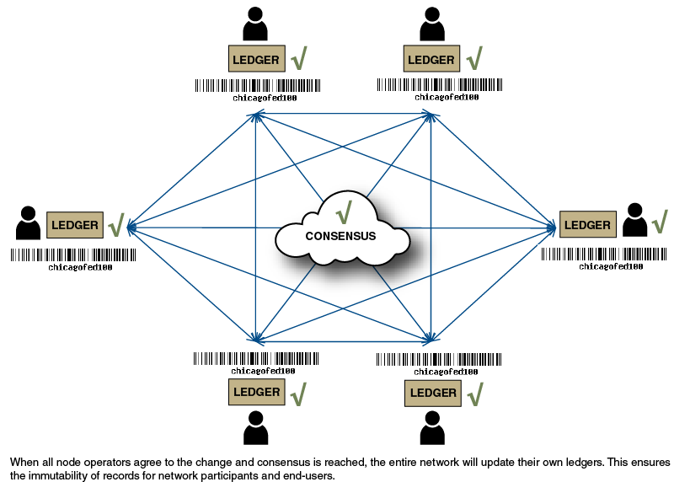
Consensus
A consensus algorithm is a procedure through which all the peers of the Blockchain network reach a common agreement about the present state of the distributed ledger.

Slide 2
Consensus
Why do we need consensus
Blockchain is a distributed system
A sequence of transactions need to be arrived at
The state of the transaction needs to be agreed upon

Slide 3
Consensus
RAFT Consensus
Raft states that each node in a replicated state machine(server cluster) can stay in any of the three states, namely, leader, candidate, follower.

Slide 4
Consensus
RAFT Consensus
Leader – Only the server elected as leader can interact with the client. All other servers sync up themselves with the leader. At any point of time, there can be at most one leader(possibly 0, which we shall explain later)
Follower – Follower servers sync up their copy of data with that of the leader’s after every regular time intervals. When the leader server goes down(due to any reason), one of the followers can contest an election and become the leader.
Candidate – At the time of contesting an election to choose the leader server, the servers can ask other servers for votes. Hence, they are called candidates when they have requested votes. Initially, all servers are in the Candidate state.

Slide 5
Consensus
RAFT Consensus

Slide 6
Consensus
Proof Of Work (PoW) Based Blockchain Consensus
The process of verifying the transactions in the block to be added, organizing these transactions in a chronological order in the block and announcing the newly mined block to the entire network does not take much energy and time. The energy consuming part is solving the ‘hard mathematical problem’ to link the new block to the last block in the valid blockchain.

Slide 7
Consensus
Proof Of Work (PoW) Based Blockchain Consensus
Demo Java Proof of work

Slide 8
Consensus
Proof Of Stake (PoS) Based Blockchain Consensus
In Proof of Stake, miners/validators are required to stake their tokens/balance in order to be chosen as the next block creator. Therefore, the miner that stakes the most amount of its currency has the highest chance of being chosen as the leader and creating the next block. Some blockchain solutions don’t follow such principle and instead choose the miner on a random basis.

Slide 9
Consensus
Proof Of Stake (PoS) Based Blockchain Consensus
Demo Proof of Stake

Slide 10
Consensus
Delegated Proof-of-Stake (DPoS) Based Blockchain Consensus
Demo Proof of Stake

Slide 11
Consensus
Proof of Elapsed Time (PoET)
Proof of elapsed time (PoET) is a blockchain network consensus mechanism algorithm that prevents high resource utilization and high energy consumption and keeps the process more efficient by following a fair lottery system. The algorithm uses a randomly generated elapsed time to decide mining rights and block winners on a blockchain network. By running a trusted code within a secure environment, the PoET algorithm also enhances transparency by ensuring lottery results are verifiable by external participants.

Slide 12
Consensus
Proof of Elapsed Time (PoET)
Proof of elapsed time (PoET) is a blockchain network consensus mechanism algorithm that prevents high resource utilization and high energy consumption and keeps the process more efficient by following a fair lottery system. The algorithm uses a randomly generated elapsed time to decide mining rights and block winners on a blockchain network. By running a trusted code within a secure environment, the PoET algorithm also enhances transparency by ensuring lottery results are verifiable by external participants.

